Slide 1


Mitchell Keomoungkhoune
Data Analyst Assignment

Slide 2

Agenda
Postal Route Data for SLM Direct Mailing in Atlanta
Client Mail Plan
Machine Learning Model: Postal Routes
Share Local Media: Data Analyst Assignment - Mitchell Keomoungkhoune

Slide 3
Agenda
Background of Data
Objectives
Results and Discussion
Conclusion
Future Works and Research
Share Local Media: Data Analyst Assignment - Mitchell Keomoungkhoune

Slide 4
Background of Data
Postal Route Data for Atlanta
Client Zip Ranking
Previously Mailed Geocodes
List of Orders (at line-item level) Attributed to Mailed and Holdout Customers for Recent Campaign
Share Local Media: Data Analyst Assignment - Mitchell Keomoungkhoune

Slide 5
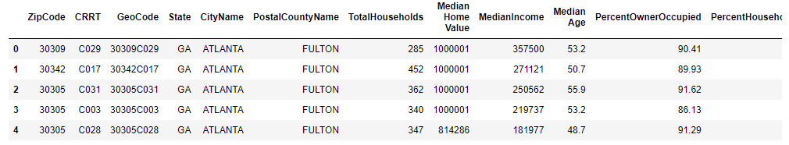
Dataset 1A: Postal Route Data for Atlanta
Zip Code and Geocode
Total Households, Median Income, and Median Age
Percent Owner Occupied and Percent Household with Children
291 observations
Share Local Media: Data Analyst Assignment - Mitchell Keomoungkhoune

Slide 6
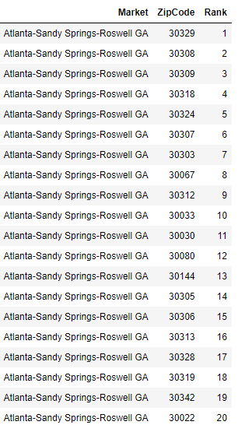
Dataset 1B: Client Zip Ranking
Includes Market, Zip Code, and Rank
Each rank unique to Zip Code
20 Ranks from 1-20
Share Local Media: Data Analyst Assignment - Mitchell Keomoungkhoune

Slide 7
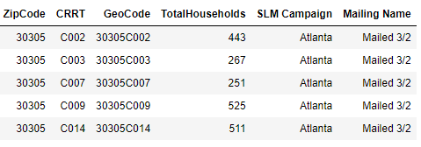
Dataset 1C: Previously Mailed Geocodes
Zip Code, GeoCode, and Total Households
CRRT, SLM Campaign, and Mailing Name
358 observations
Share Local Media: Data Analyst Assignment - Mitchell Keomoungkhoune

Slide 8
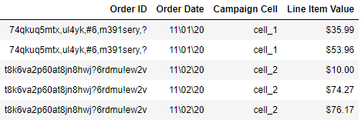
Dataset 2A: List of Orders (at line-item level)
Order ID, Order Date, Campaign Cell, and Line-Item Value
Client Mail Plan – Status, Format, Population, Total Cost to Mail
1016 observations
Share Local Media: Data Analyst Assignment - Mitchell Keomoungkhoune

Slide 9
Objectives
Perform data preprocessing techniques on raw data
Generate insights using data analysis to evaluate datasets
Develop conclusions and provide recommendations
Propose future works and research
Share Local Media: Data Analyst Assignment - Mitchell Keomoungkhoune

Slide 10

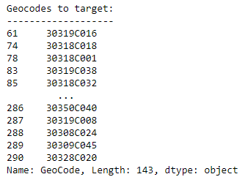
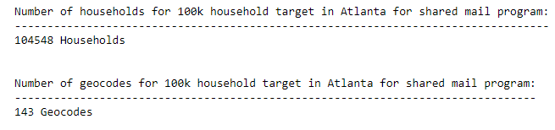
Postal Route Data - Atlanta
# of households for postal route constraints:
Median household income > $80,000
Median household age: 40-55
Parameters for 100,000 household target for shared mail program in Atlanta:
59,869 Households
Share Local Media: Data Analyst Assignment - Mitchell Keomoungkhoune

Slide 11
Postal Route Data – Zip Ranking
Incorporating zip ranking to improve targeting
Merged Dataset 1A (Postal Route Data) & Dataset 1B (Client Zip Ranking)
Postal Route Data
Zip Ranking
Share Local Media: Data Analyst Assignment - Mitchell Keomoungkhoune

Slide 12
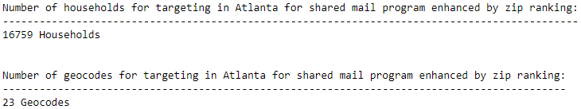
Postal Route Data – Zip Ranking
Incorporating zip ranking to improve targeting
Merged Dataset 1A (Postal Route Data) & Dataset 1B (Client Zip Ranking)
Share Local Media: Data Analyst Assignment - Mitchell Keomoungkhoune

Slide 13
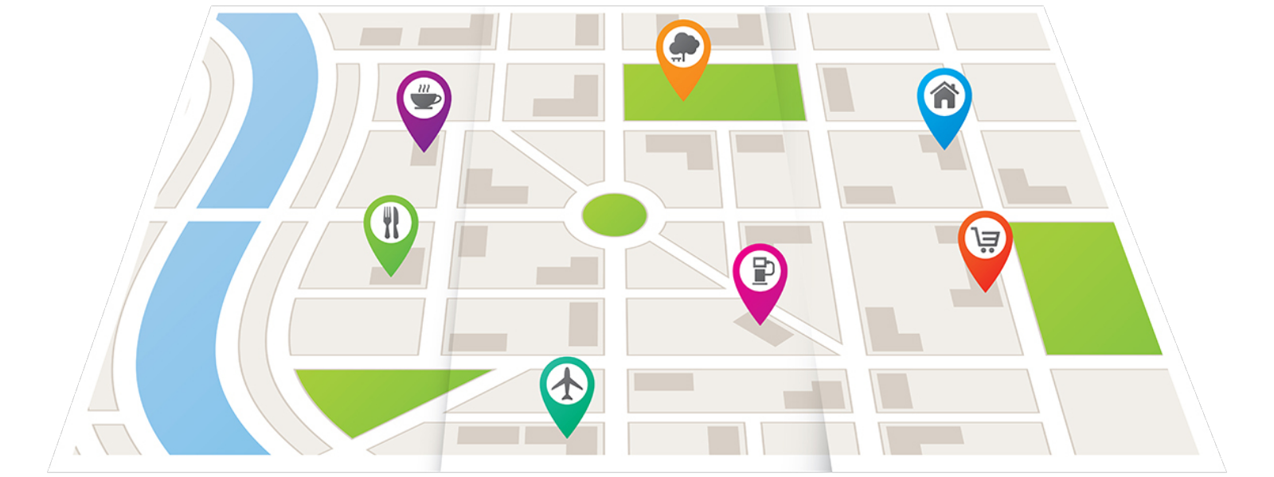
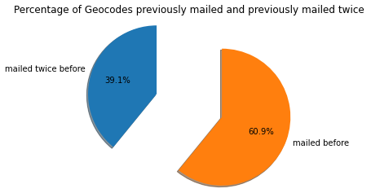
Postal Route Data – Geocodes
Percentage of geocodes mailed before: 60.9%
Percentage of geocodes mailed twice before: 39.1%
Share Local Media: Data Analyst Assignment - Mitchell Keomoungkhoune

Slide 14
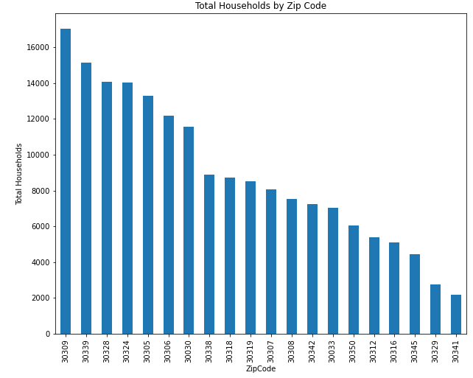
Postal Route Data – Household Breakdown
Top Zip Codes (Total Households):
30309
30339
30328
30324
Share Local Media: Data Analyst Assignment - Mitchell Keomoungkhoune

Slide 15
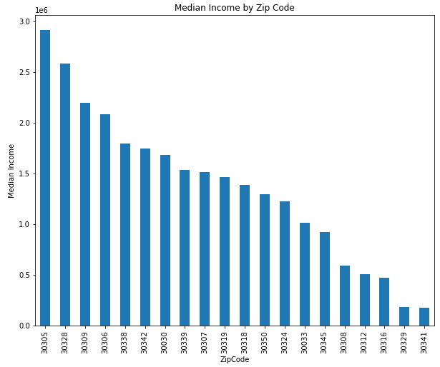
Postal Route Data – Household Breakdown
Top Zip Codes (Median Income):
30305
30328
30309
30306
Zip codes 30328 and 30309 also rank top for Total Households
Share Local Media: Data Analyst Assignment - Mitchell Keomoungkhoune

Slide 16
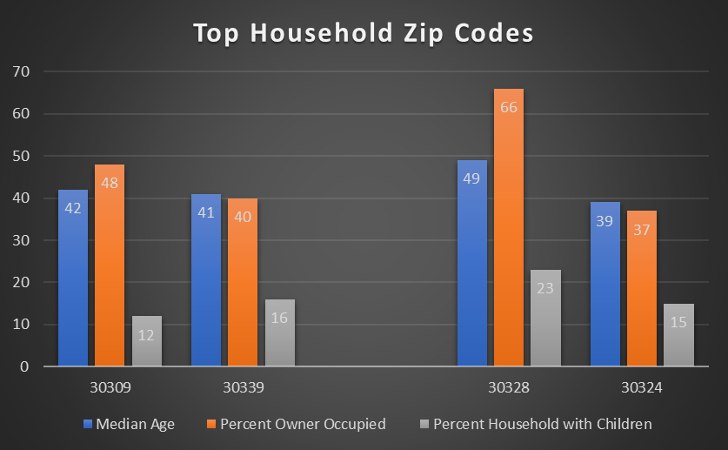
Postal Route Data – Household Breakdown
Avg. Median Age: 43 years
Avg. % Owner Occupied: 48%
Avg. % Household w/ Children: 17%
Share Local Media: Data Analyst Assignment - Mitchell Keomoungkhoune

Slide 17
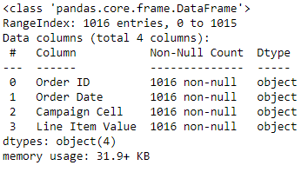
List of Orders – Data Preprocessing
Check for null/missing values and data type
Check for outliers
Use .info() to generate report
1016 non-null observations
Datatype for Line-Item Value: “object”
Share Local Media: Data Analyst Assignment - Mitchell Keomoungkhoune

Slide 18
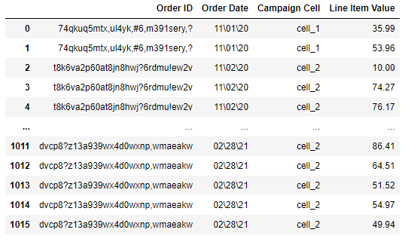
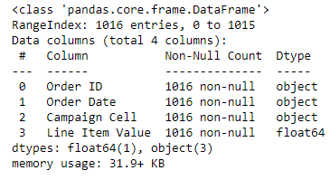
List of Orders – Data Preprocessing
Use pandas to_numeric function to change dollar values for Line-Item Value into float values
Share Local Media: Data Analyst Assignment - Mitchell Keomoungkhoune

Slide 19
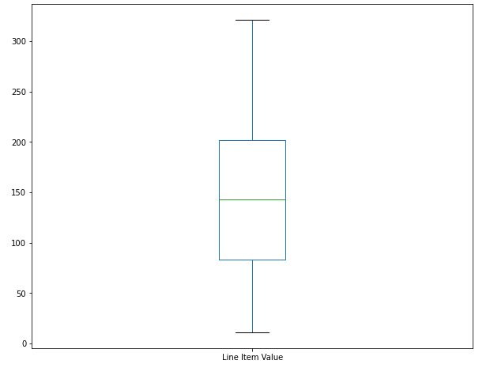
List of Orders – Data Preprocessing
Use boxplot to examine any outliers within cost per order data

Slide 20
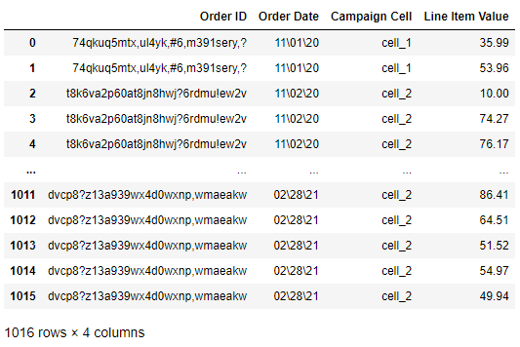
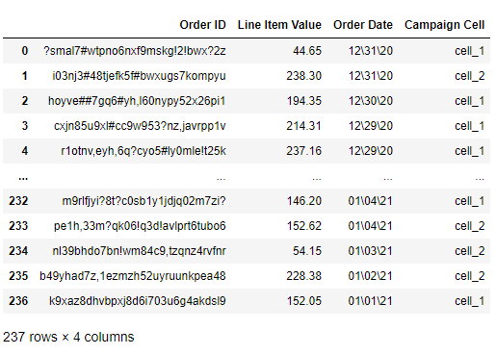
List of Orders – Data Preprocessing
Consolidated dataset by merging Order IDs and summing corresponding Line-Item Values
Filtered out dates outside of 90-day attribution window (11/10/20 – 2/8/21)
Raw data
Cleaned Data
Share Local Media: Data Analyst Assignment - Mitchell Keomoungkhoune

Slide 21

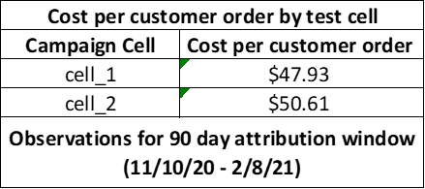
List of Orders – Test Cells
Merged cleaned Dataset 2A with Client Mail Plan
Cost per customer order for Test Cell 1: $47.93
Cost per customer order for Test Cell 2: $50.61
Share Local Media: Data Analyst Assignment - Mitchell Keomoungkhoune

Slide 22
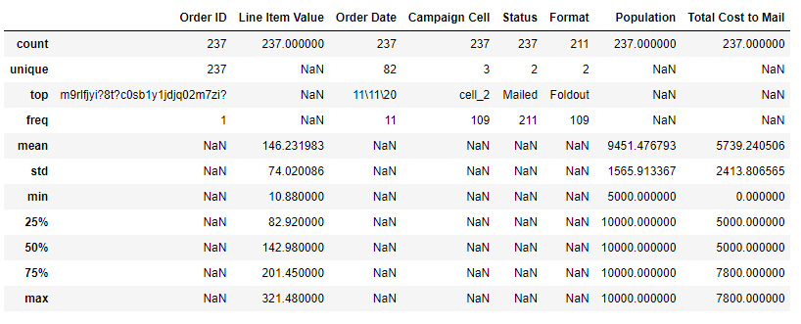
List of Orders – Test Cells Report
Share Local Media: Data Analyst Assignment - Mitchell Keomoungkhoune

Slide 23
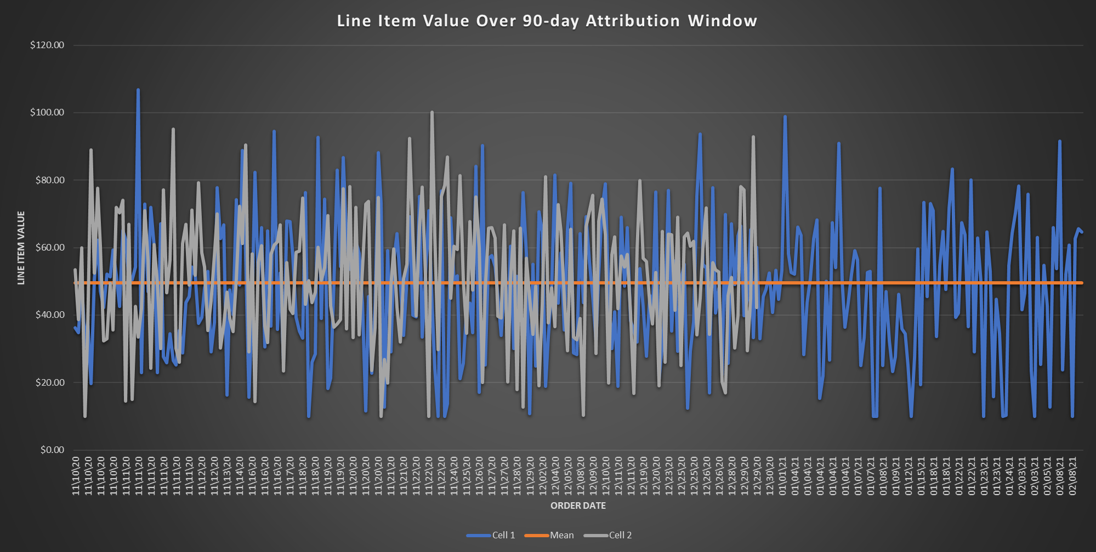
Share Local Media: Data Analyst Assignment - Mitchell Keomoungkhoune

Slide 24
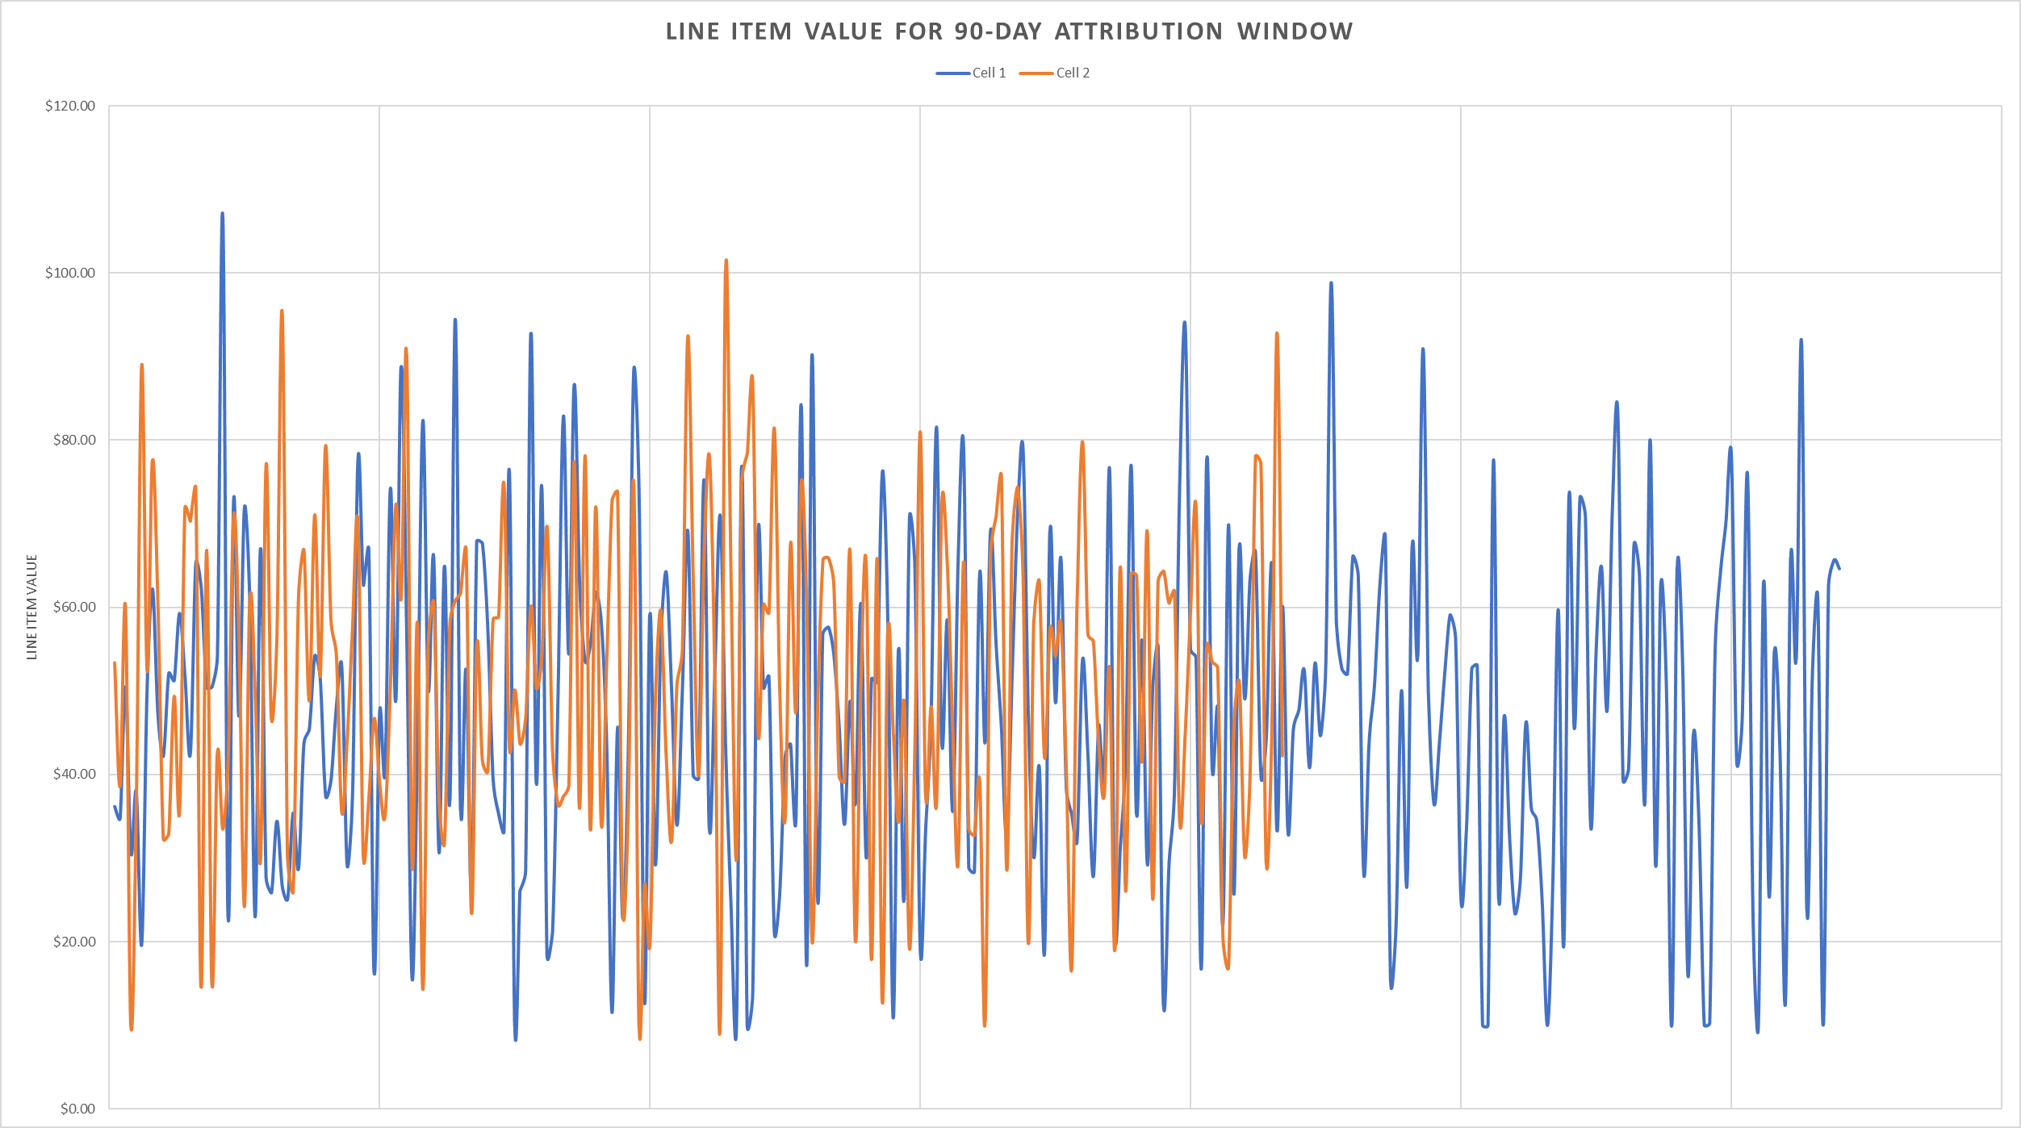

Slide 25

RR – Response Rate
Percentage of customers on mailing list who respond to direct mailing campaigns
Direct Marketing Association – “The average response rate for direct mailing house lists is 9% and 5% for prospective lists.”
KPI (Key Performance Indicator) to adequately assess efficiency of both mail campaigns for client
RR determined by comparing number of mailings to number of orders or instances where consumer products are purchased
Share Local Media: Data Analyst Assignment - Mitchell Keomoungkhoune

Slide 26
Future Works/Research – Logistic Regression
Logistic Regression – predictive analysis to describe data and relationship between dependent dichotomous variable and one or more nominal, ordinal, interval, or ratio-level independent variable
Response model to rank order perspective consumers based on likelihood to respond and respond into final decision as result of direct mailing
Easier to implement, interpret, and very efficient to train
Share Local Media: Data Analyst Assignment - Mitchell Keomoungkhoune

Slide 27



Future Works/Research
RFM (Recency, Frequency, and Monetary Value) Models – Measures how recently purchase was made, how often product is purchased, and how large purchase order is
ML software’s and programs: Torch, TensorFlow, Keras, PyTorch, and Caffe
Share Local Media: Data Analyst Assignment - Mitchell Keomoungkhoune

Slide 28
References
http://cs229.stanford.edu/proj2017/final-reports/5242050.pdf
https://www.investopedia.com/terms/r/rfm-recency-frequency-monetary-value.asp
https://www.statisticssolutions.com/free-resources/directory-of-statistical-analyses/what-is-logistic-regression/
https://www.themailshark.com/resources/guides/how-to-track-measure-direct-mail/#:~:text=According%20to%20the%20Direct%20Marketing,one%20percent%20is%20not%20unusual.
https://www.themailshark.com/resources/guides/how-to-track-measure-direct-mail/
https://www.msp-pgh.com/direct-mail-marketing-metrics/
https://sharelocalmedia.com/
Share Local Media: Data Analyst Assignment - Mitchell Keomoungkhoune

Slide 29

Thank you! Are there any questions?
Share Local Media: Data Analyst Assignment - Mitchell Keomoungkhoune

